Slide 1
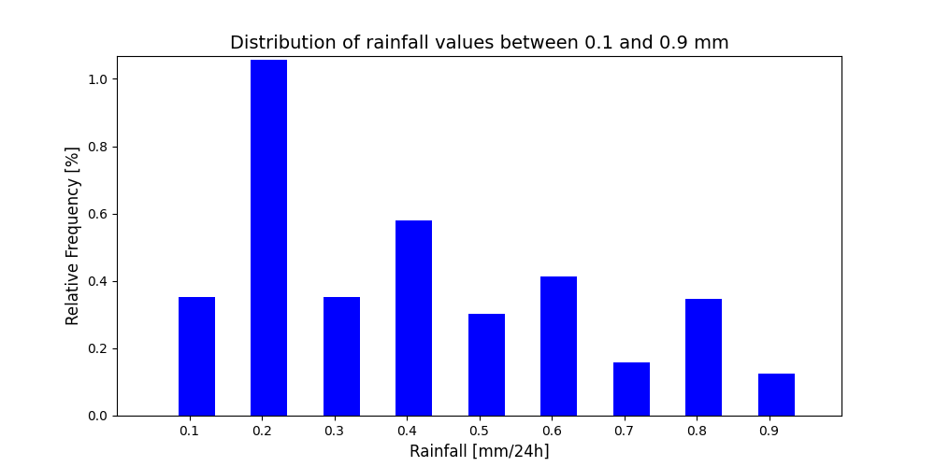
1
For rainfall totals smaller than 1.0 mm (Figure 1), values equal to 0.2, 0.4, 0.6, and 0.8 appear more frequently than values equal to 0.1, 0.3, 0.5, 0.7, and 0.9. This pattern is consistent with the most common resolution available in rain gauges (i.e., 0.2 mm). This pattern is observed throughout all rainfall values, as shown in the subsequent figures (e.g. Figure 2a and 2b, next slide).

Slide 2
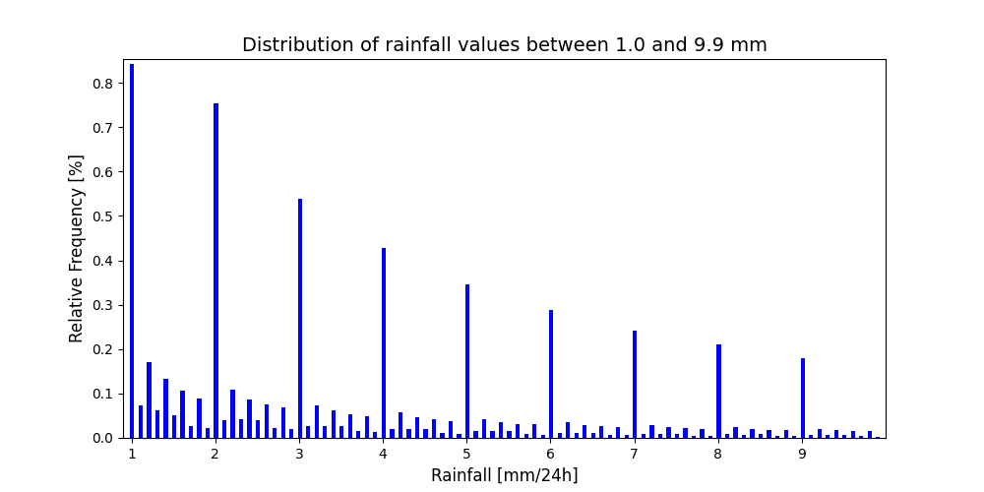
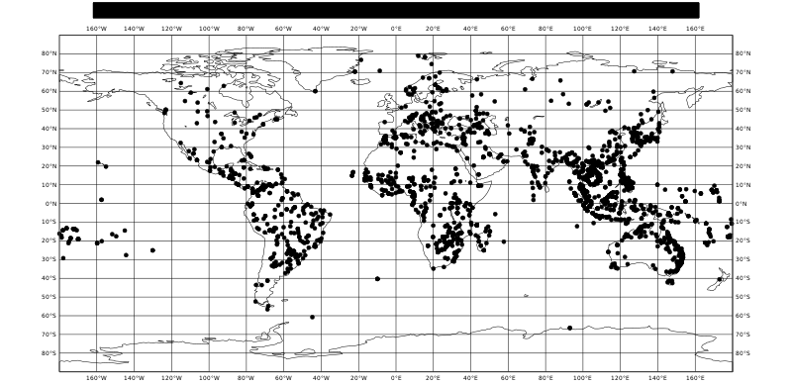
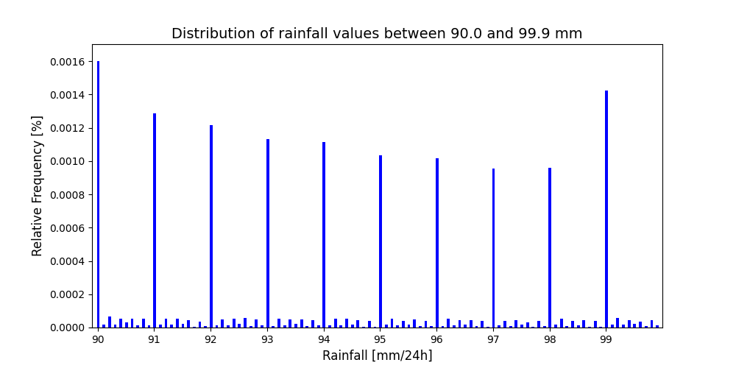
The distribution of rainfall values is expected to follow an exponential distribution because smaller rainfall totals are expected to be observed more frequently than higher rainfall totals. This is clearly observed throughout all rainfall values between 1 mm and 100 mm (only distributions for rainfall values between 1mm and 10 mm, and between 90 mm and 100 mm are shown in Figure 2a and 2c, respectively).
However, integer values (i.e., x.0) appear much more frequently than rainfall totals with decimals values (i.e., x.1, …, x.9). The ratio can be as much as four times greater. This pattern is observed throughout all rainfall values. This pattern might be the consequence of rough approximations to the closest integer value when reporting the observations, as there are no physical reasons to have .0 values appearing more frequently than other decimal values.​
Particular attention should be given to the integer value equal to 99.0 mm (2376 instances). Such value is recorded with a higher frequency than other integer values. Since there is no physical reason for this to happen, it is hypothesized that such value might have been misreported. However, there is no special spatial pattern associated to such a value that might make us think the recording of such value is wrong, so all values are kept (Figure 2b.1).
2a
Spatial distribution for tp = 99.0 mm/24h
2b
2b.1

Slide 3
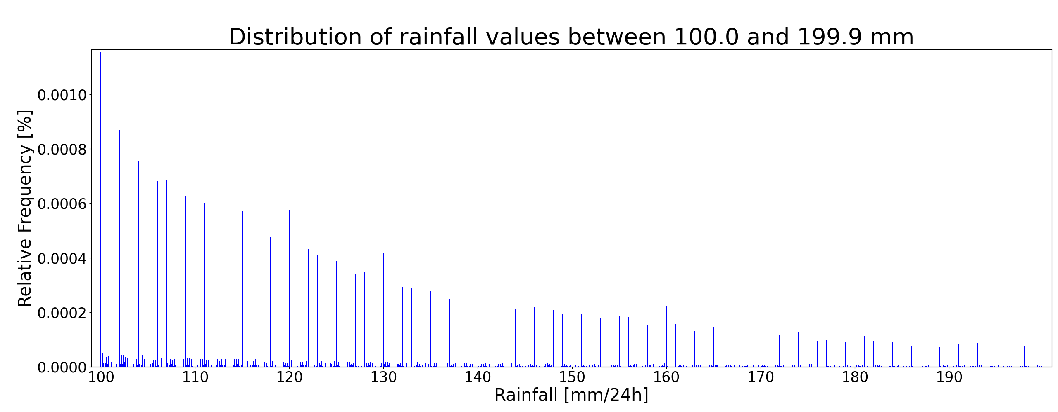
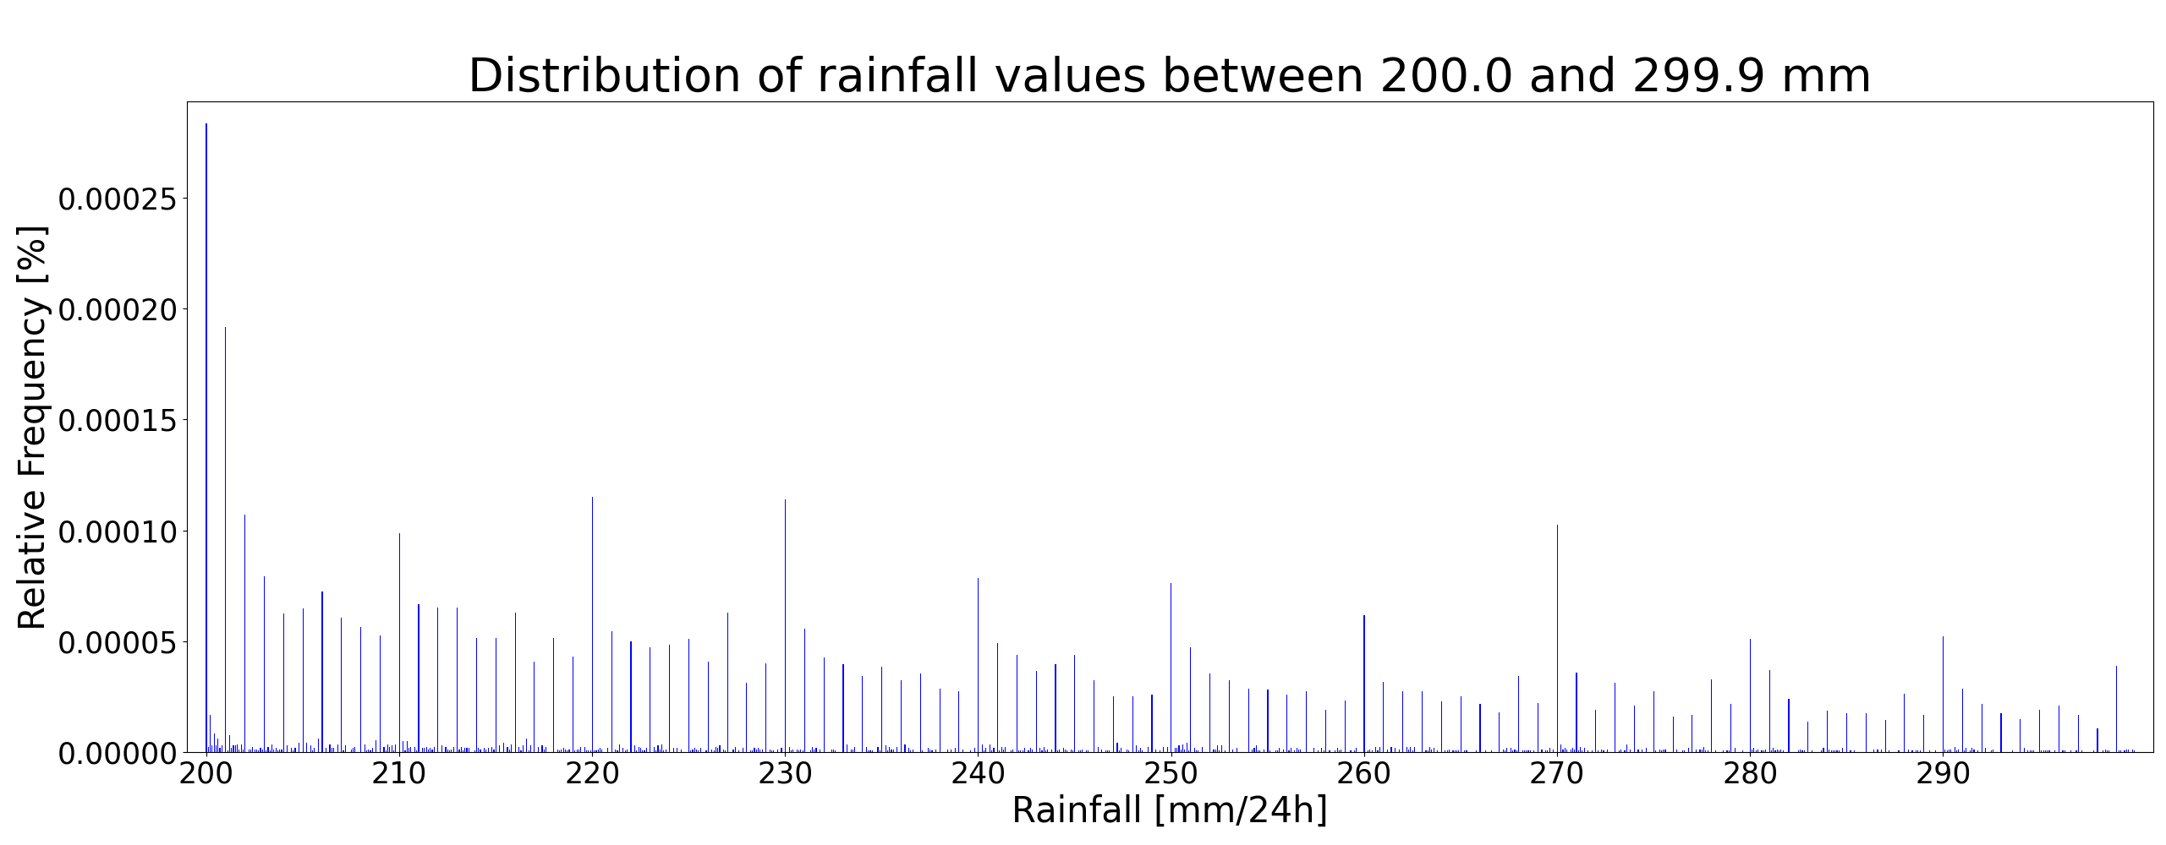
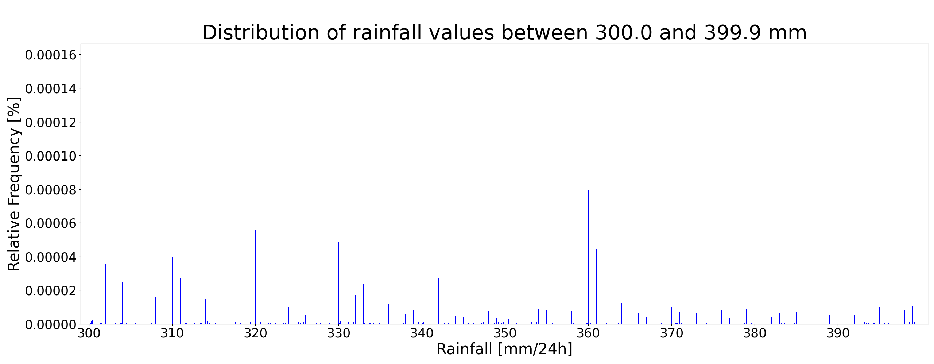
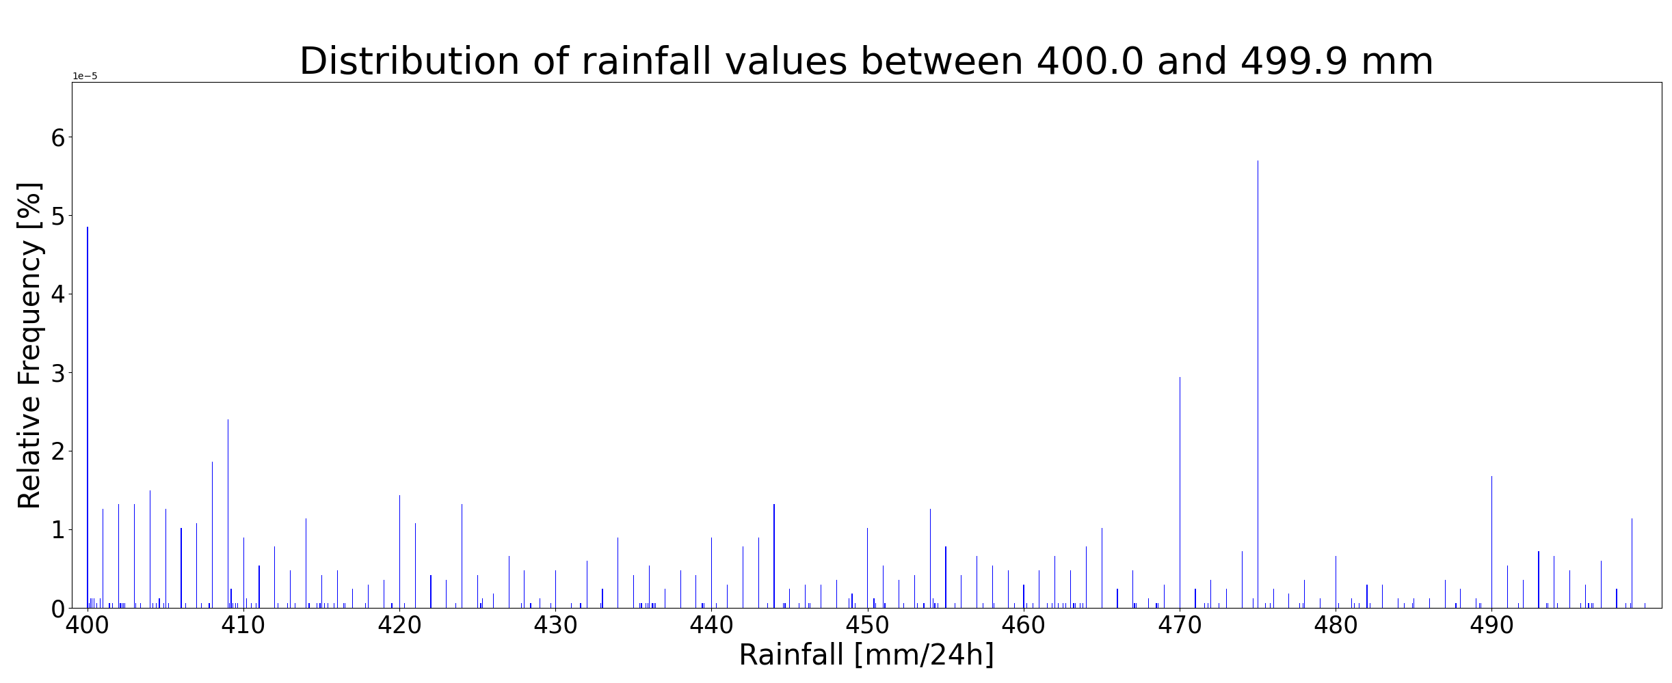
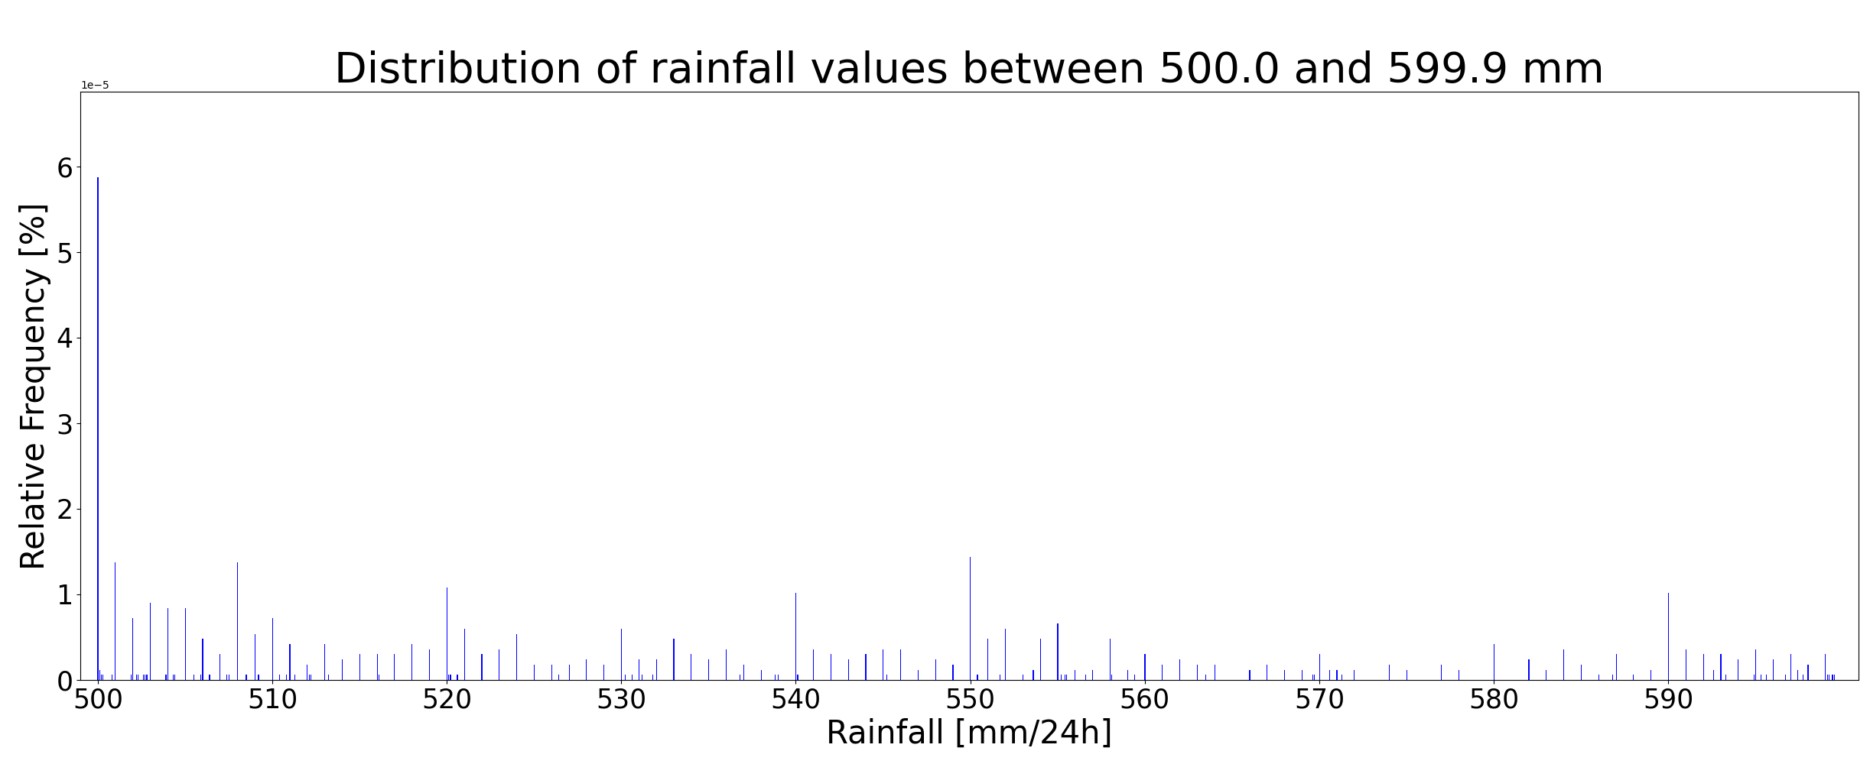
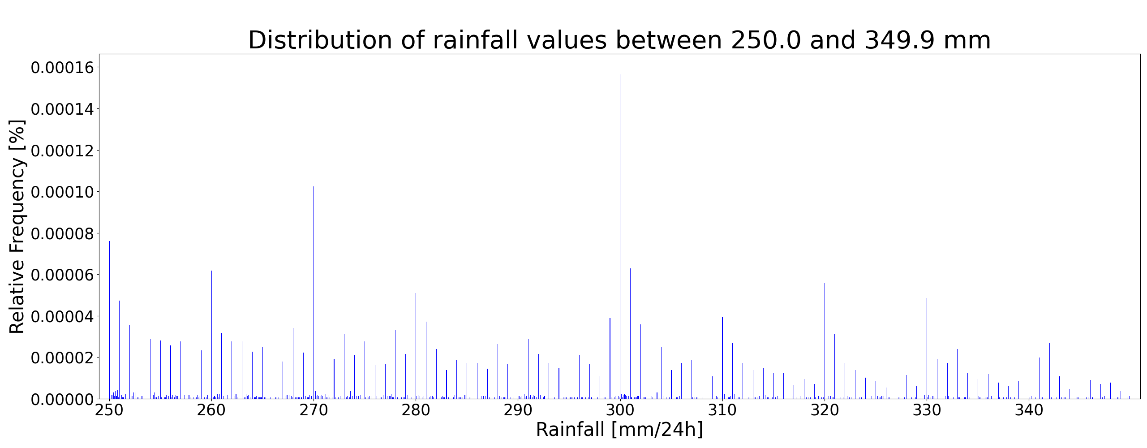
From values between 100.0 mm and 599.9 mm (Figures 3a to 3e) a similar pattern of that observed in Figures 1 and 2a and 2b is observed.
One aspect to highlight is that integer tens values (110.0, 120.0, …, 590.0 mm) appear more frequently than other integer values but there is no physical reason for these values to be observed more frequently. Furthermore, also integer hundreds (100.0, 200.0, …., 500.0 mm) appear more frequently than any other values, as shown in figure 3f for the value 300.0 mm.
Another aspect to consider is that for bigger rainfall totals, the clean exponential pattern of the smaller rainfall totals gets contaminated by issues with the sampling of more rare rainfall totals. Only few exceptions are highlighted as the rainfall values appear with a much higher frequency with no apparent physical reason: 360.0 mm (163 instances) in figure 3c, and 470.0 (49 instances) mm and 475.0 mm (95 instances) in figure 3d. The spatial distribution of such values (see next slide) shows that there some clusters in Central America (Guatemala, for the value 360.0 mm in figure 3c.1) and in Central Africa (Ciad, for the values equal to 470.0 mm in figure 3d.1 and 475.0 mm in figure 3d.2). It might be worth looking into these single values.
3a
3b
3c
3d
3e
3f

Slide 4
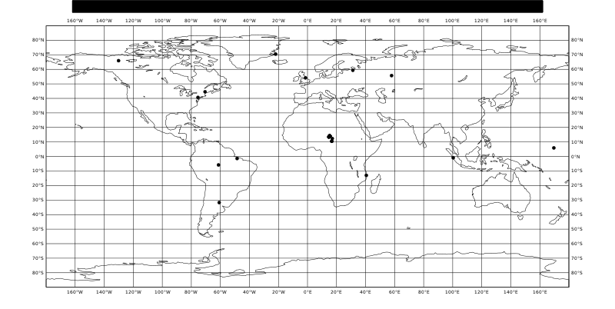
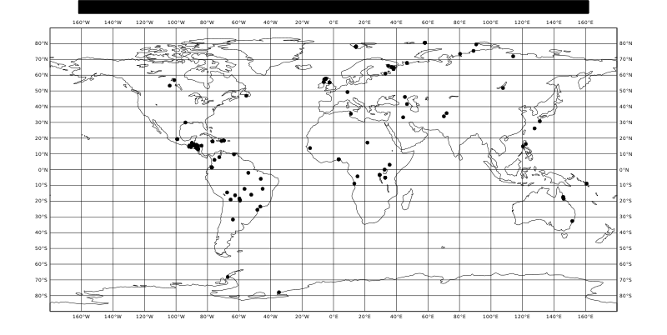

3d
3c
Spatial distribution for tp = 470.0 mm/24h
Spatial distribution for tp = 360.0 mm/24h
3d.1
Spatial distribution for tp = 475.0 mm/24h
3c.1
3d.2

Slide 5
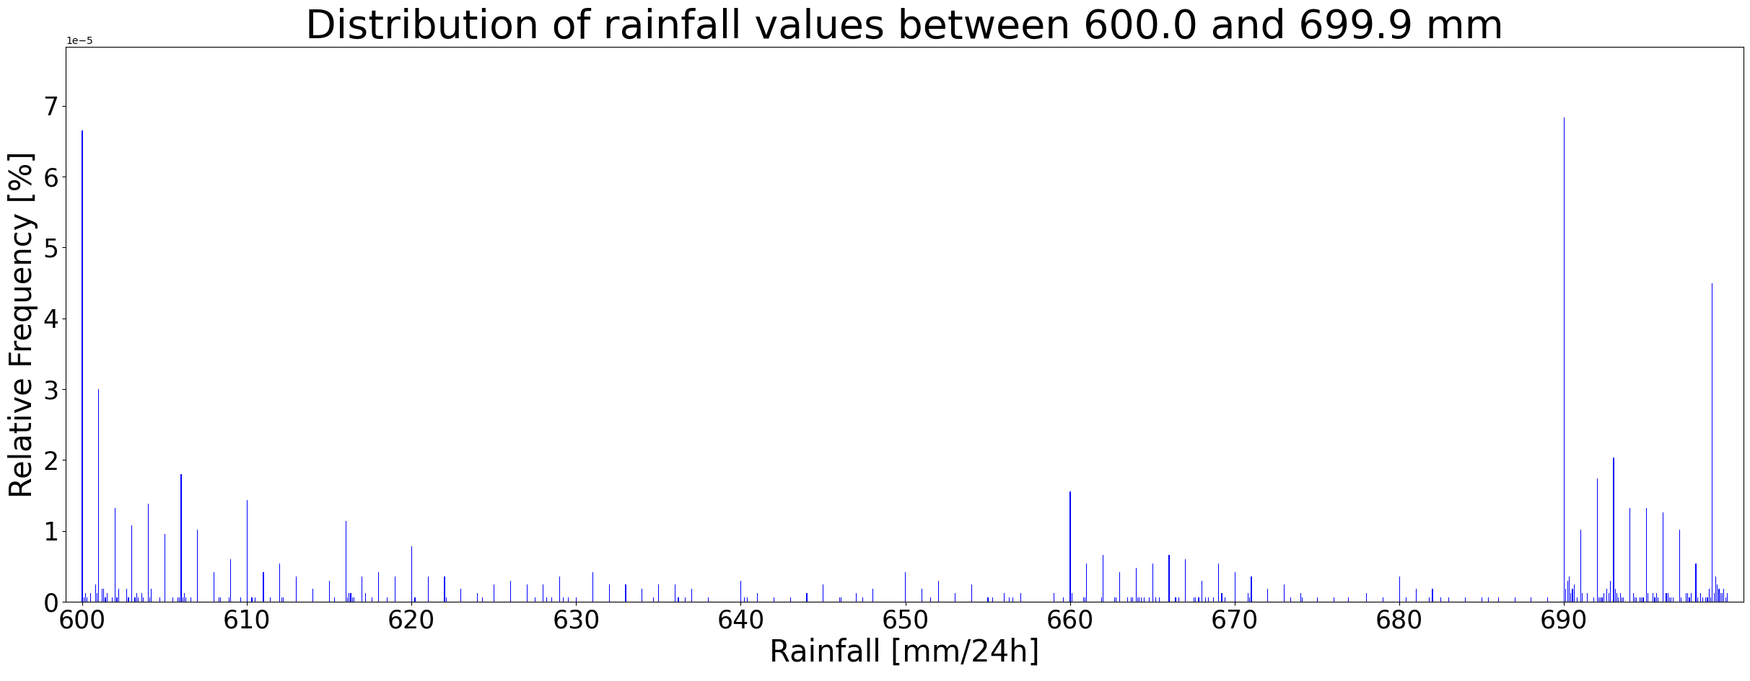
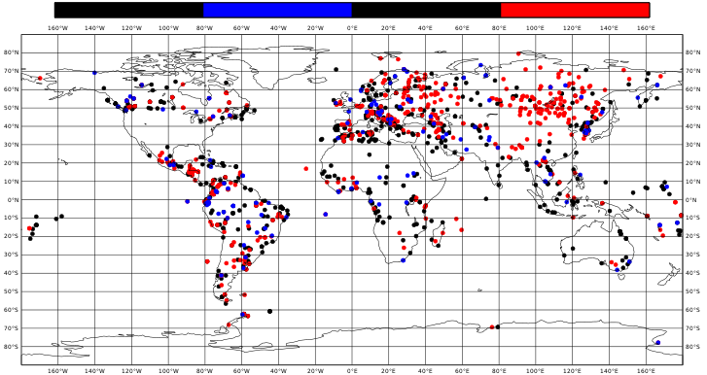
It was noticed that some categories of rainfall values in figure (4a) have a greater frequency of occurrences, e.g., between 660.0 mm and 669.9 mm (highlighted by the blue circle), and between 690.0 mm and 699.9 mm (highlighted by the red circle). There is no clear physical explanation why this specific range of values might be observed more frequently than others. This pattern might be due to an error in reporting these specific values.
From the spatial distribution of rainfall values between 600.0 mm and 699.99 mm (figure 4b), it does not appear that there is a specific spatial distribution for the values between 660.0 mm and 669.9 mm (blue dots in figure 4b) and values between 690.0 mm and 699.9 mm (red dots in figure 4b). The only thing that it is noticed, is that they appear very frequently in areas of the extra-tropics that look suspicious, such as Western and central Europe, Asian Russia, and Canada as such high rainfall totals should not be expected there with such high frequency.
A concerning issue is that also values outside the concerning categories (indicated with black dots in figure 4b) appear with a very suspicious high frequency outside the tropics. Therefore, the whole category of rainfall values between 600.0 mm and 699.9 mm, is questioned.
Similar considerations are done for the rainfall values between 700.0 mm and 799.9 mm (see figure 5a and 5b on the next slide), and between 800.0 mm and 899.9 mm (see figure 6a and 6b on the next slide).
What would be the best approach to remove dodgy values without removing possible real values between 600.0 mm and 899.9 mm?
4a
Spatial distribution for 600.0 <= tp <= 699.9 mm/24h
600.0 <= tp <= 659.9 mm
660.0 <= tp <= 669.9 mm
670.0 <= tp <= 689.9 mm
690.0 <= tp <= 699.9 mm
4b

Slide 6
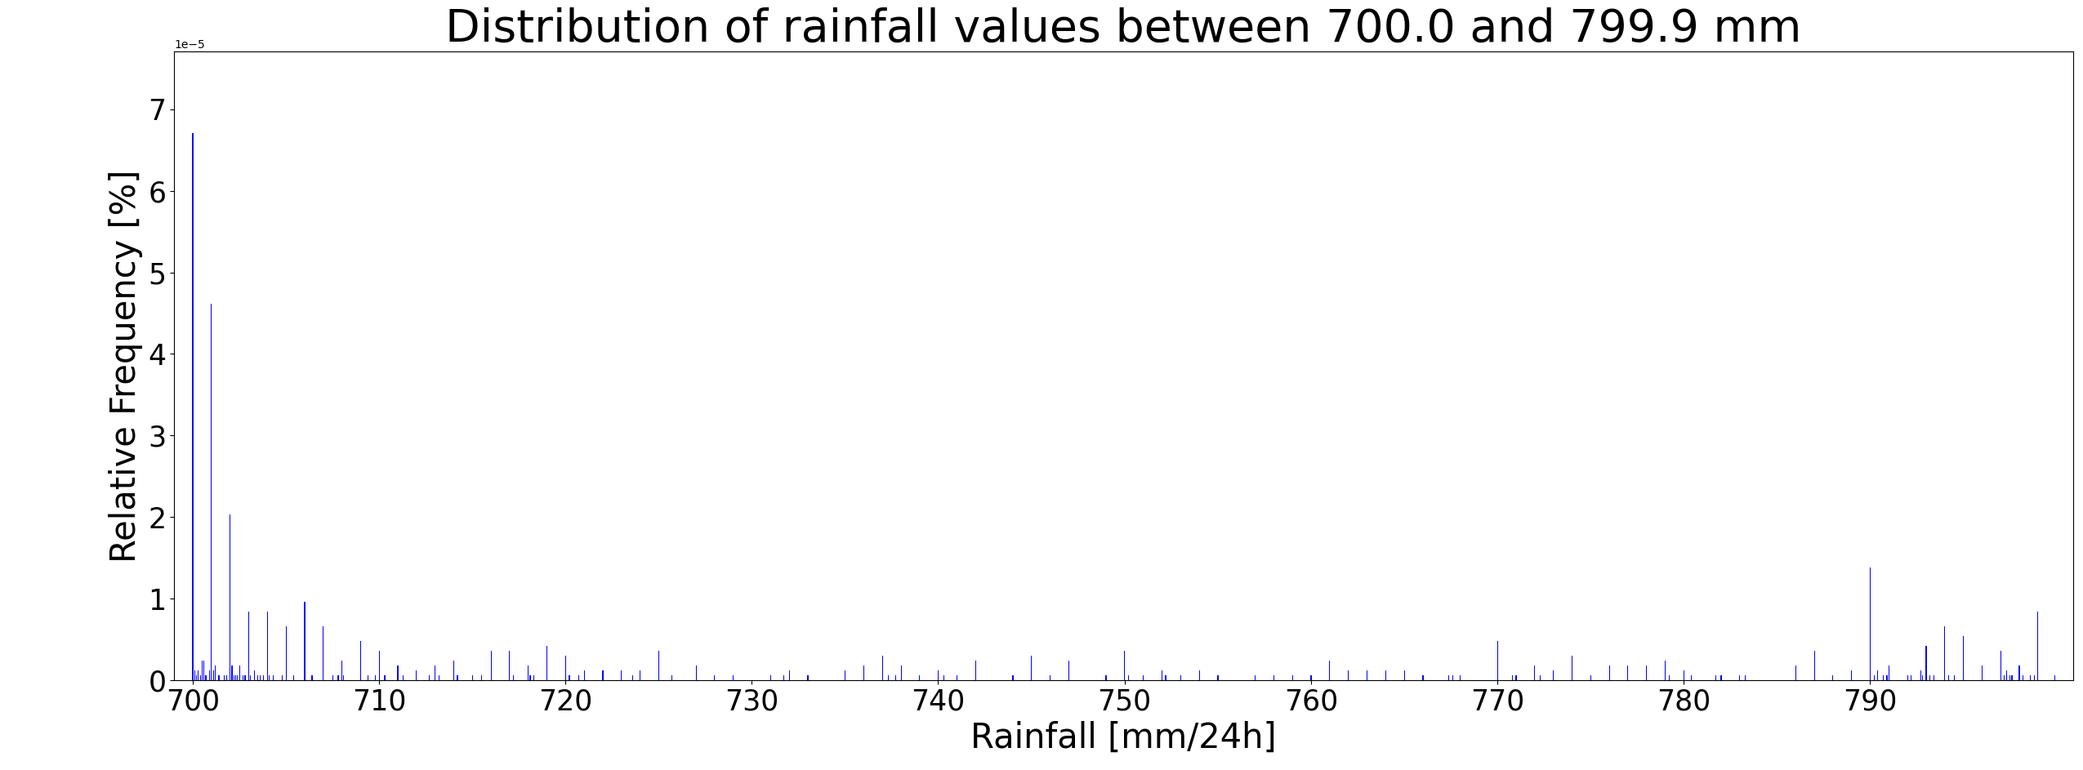
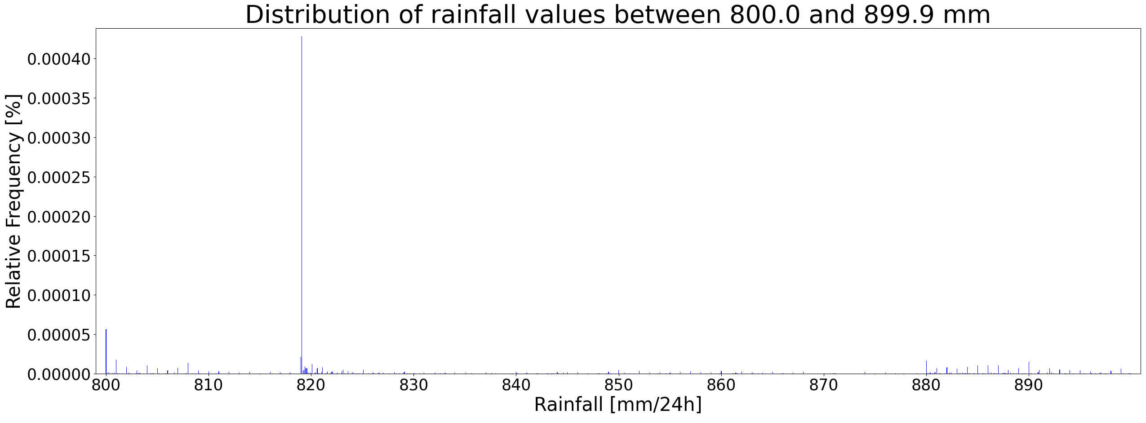
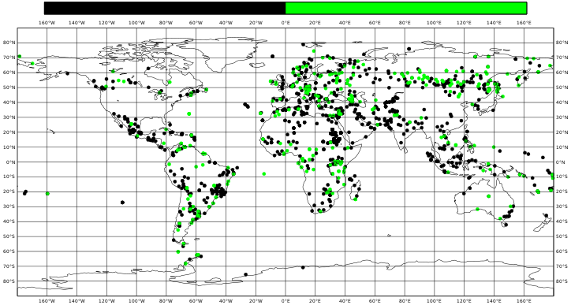
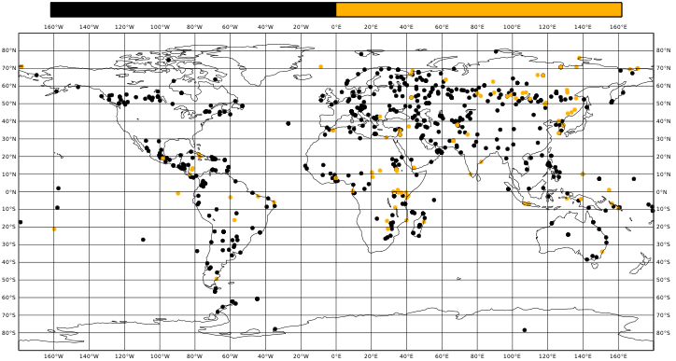
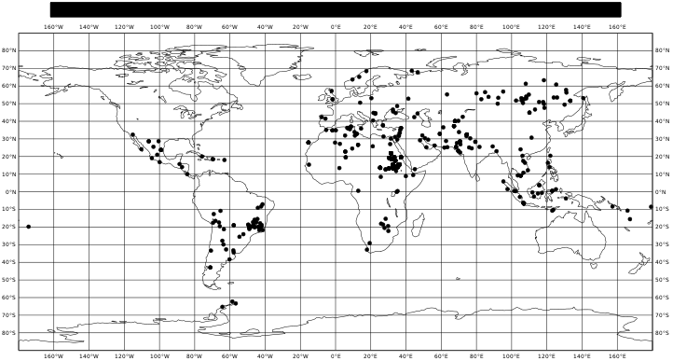
5a
6a
Spatial distribution for 800.0 <= tp <= 899.9 mm/24h
Spatial distribution for 700.0 <= tp <= 799.9 mm/24h
800.0 <= tp <= 879.9 mm
880.0 <= tp <= 899.9 mm
700.0 <= tp <= 789.9 mm
790.0 <= tp <= 799.9 mm
6b
Spatial distribution for tp = 819.1 mm/24h
One more thing to consider in the category of values between 800.0 mm and 899.9 mm (figure 6a) is the extremely higher frequency of rainfall values equal to 819.1 mm (715 instances).
From the spatial distribution of this value (figure 6c), it appears evident that there are some cluster of such value in Brazil and in Sudan and Ethiopia which might be worth investigating.
5b
6c

Slide 7
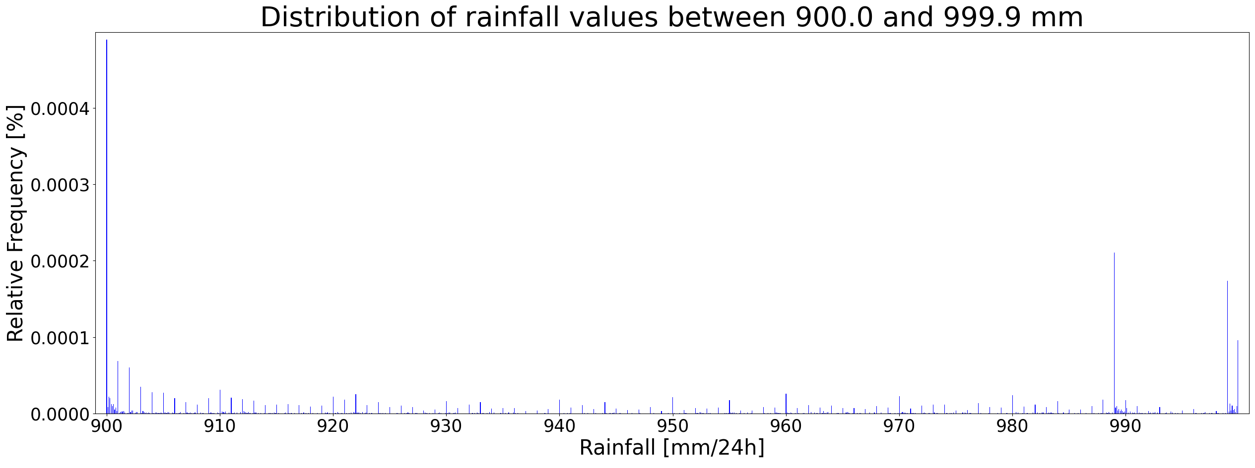
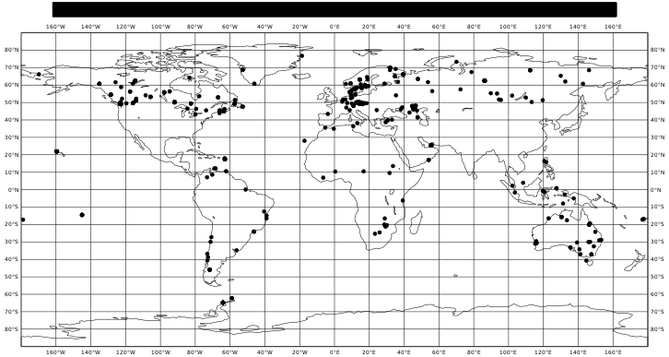
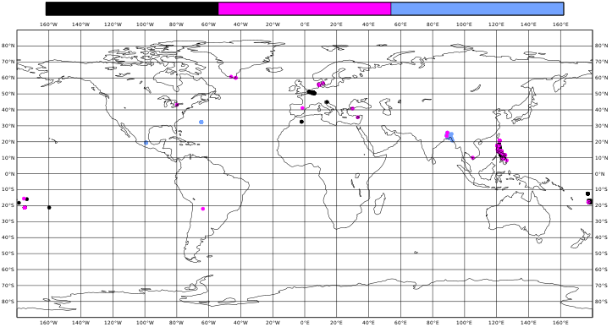
In the distribution of rainfall values between 900.0 mm and 999.9 mm (figure 7a), the values of 989.0 mm (highlighted with the black circle) and the values between 999.0 mm and 999.9 mm (highlighted with the magenta circle) appear with a suspicious higher frequency than other rainfall values. Those are values that have a specific meaning in the coding of 6-hourly rainfall totals, that might have their way in the derived 24-hourly rainfall observations.
The value 989 indicates 6-hourly rainfall observations with 989 mm or more. Figure (7b) shows that there is no specific spatial pattern for such reports, but they are likely to be wrong in any case as having 989 mm in 6-hours might be very unlikely. All these values might be eliminated from the dataset.
The values between 999.0 and 999.9 mm might be a legacy on how values between trace and 0.9 mm are reported in the 6-hourly accumulations. Perhaps, operators are reporting those small values with the same technique for 24-hourly rainfall using the code 9991, …, 9999 which then gets erroneously stored as rainfall equal to 999.1, …, 999.9 mm. The Philippines (figure 7c) appears to have most of these reports, which will be all eliminated from the dataset.
7a
Spatial distribution for 999.0 <= tp <= 999.9 mm/24h
Spatial distribution for tp = 989.0 mm/24h
tp = 999.0 mm
999.1 <= tp <= 999.8 mm
tp = 999.9 mm
7b
7c

Slide 8
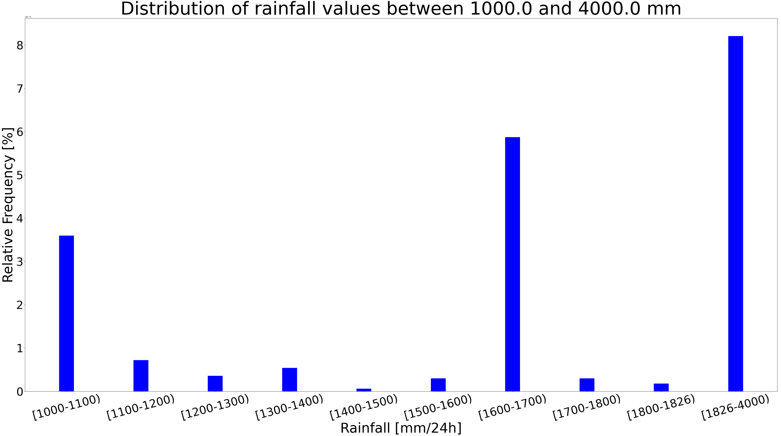
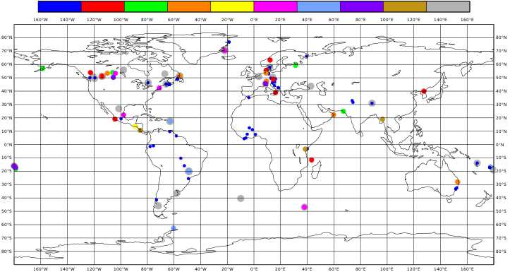
8a
Values above 1826.0 mm are deleted from the database as the world record is 1825.0 mm in Foc Foc, La Reunion.
There is also a high frequency of values between 1600.0 and 1700.0 mm (figure 8a) but they are all duplicates for the same dates, so they will be eliminated from the database.
Clusters in central Europe for values between 1000.0 and 1100.0 mm are also suspicious so they will be checked and in case eliminated from the dataset.
Spatial distribution for 1000.0 <= tp <= 4000.0 mm/24h
1000 1100 1200 1300 1400 1500 1600 1700 1800 1826 4000
8b

